Slide 1

Introduction Session on Amazon Web Services
By – Ishita Gandhi
Data and Cloud Engineer at PricewaterHouse Coopers (PwC)

Slide 2

About Me
I am an Experienced Data Engineer with 4+ year experience in interpreting and
transforming data using various BigData tools
and frameworks to drive success business solutions.
Ishita Gandhi
Work Role & History:
Building data pipelines, data transformations using AWS, Azure Data factory, Databricks, pysaprk, SQL, Shell scripting, Azure data lake storage.
Performing SQL transformations using T-SQL, Joins, Pivot, indexing, CTE query, window functions for data manipulation and derive optimize business solutions.
Build CI/CD pipelines in Azure Devops and integrate notebooks with storage layers of Azure Data lake.
Developed a Hadoop Data lake shared platform to using Sqoop, Hive, Spark, HDFS, and Power BI to visualize the data
Build ETL pipeline and mapping to cleanse and load a huge amount of data.
Developed dashboards in Power BI Desktop to analyze the data for end users by collaborating with the stakeholders.
Involved in the process of data ingestion, data transformation, data querying, data storage, data movement, data visualization.
Eduction History:
B.Tech in Computer Science and Engineering.
As a Trainer:
3+ year as a Data Engineer Trainer
Conducted various corporate and Tech sessions on Data Analytics, Data Engineer and AI.
Skills: Python, Spark, SQL, PySpark, AWS, Azure, Power BI, Hadoop, Shell Scripting, GIT,

Slide 3
Overview
What is Cloud Computing
AWS Cloud Architecture
Services in AWS
Amazon Redshift
AWS Lambda
Amazon Ec2
Practical Labs
Things to Remember

Slide 4
What is Cloud Computing?
Cloud computing is the on-demand delivery of IT resources over the Internet with pay-as-you-go pricing. Instead of buying, owning, and maintaining physical data centers and servers, you can access technology services, such as computing power, storage, and databases, on an as-needed basis from a cloud provider like Amazon Web Services (AWS).

Slide 5
Benefits of Cloud Computing
Agility
The cloud gives you easy access to a broad range of technologies so that you can innovate faster and build nearly anything that you can imagine. You can quickly spin up resources as you need them–from infrastructure services, such as compute, storage, and databases, to Internet of Things, machine learning, data lakes and analytics, and much more.
Elasticity
With cloud computing, you don’t have to over-provision resources up front to handle peak levels of business activity in the future. Instead, you provision the amount of resources that you actually need. You can scale these resources up or down to instantly grow and shrink capacity as your business needs change.
Cost savings
The cloud allows you to trade capital expenses (such as data centers and physical servers) for variable expenses, and only pay for IT as you consume it. Plus, the variable expenses are much lower than what you would pay to do it yourself because of the economies of scale.

Slide 6
Types of Cloud Computing
Infrastructure as a Service (IaaS)
IaaS contains the basic building blocks for cloud IT. It typically provides access to networking features, computers (virtual or on dedicated hardware), and data storage space. IaaS gives you the highest level of flexibility and management control over your IT resources. It is most similar to the existing IT resources with which many IT departments and developers are familiar.
Platform as a Service (PaaS)
PaaS removes the need for you to manage underlying infrastructure (usually hardware and operating systems), and allows you to focus on the deployment and management of your applications. This helps you be more efficient as you don’t need to worry about resource procurement, capacity planning, software maintenance, patching, or any of the other undifferentiated heavy lifting involved in running your application.
Software as a Service (SaaS)
SaaS provides you with a complete product that is run and managed by the service provider. In most cases, people referring to SaaS are referring to end-user applications (such as web-based email). With a SaaS offering, you don’t have to think about how the service is maintained or how the underlying infrastructure is managed. You only need to think about how you will use that particular software.

Slide 7
What is AWS?
Amazon Web Services (AWS) is the world’s most comprehensive and broadly adopted cloud platform, offering over 200 fully featured services from data centers globally.
Amazon web service is an online platform that provides scalable and cost-effective cloud computing solutions.
AWS is a broadly adopted cloud platform that offers several on-demand operations like compute power, database storage, content delivery, etc., to help corporates scale and grow.
Applications:
Storage and Backup
Websites
Gaming
Mobile, Web and Social Applications

Slide 8
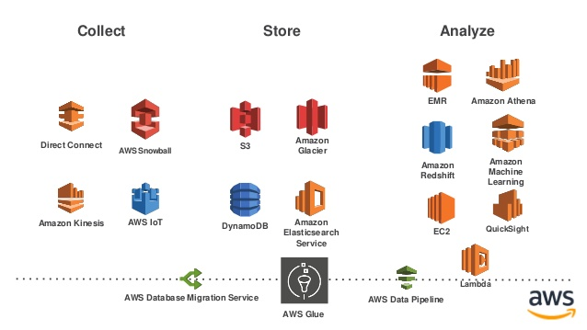
AWS Architecture

Slide 9
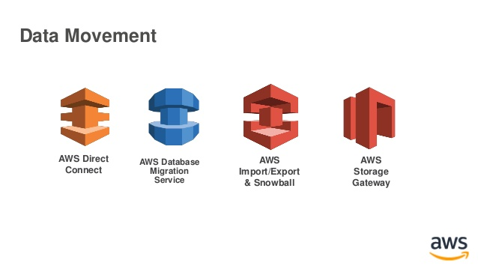
Services in AWS

Slide 10
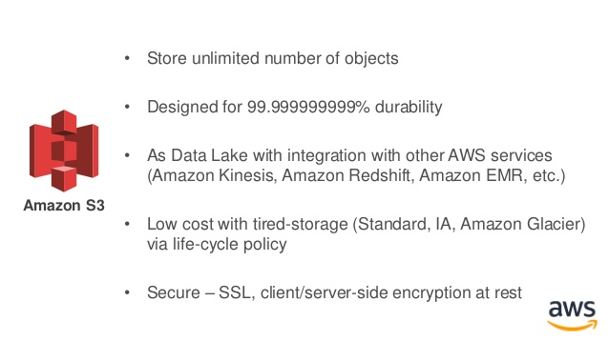
Storage And Databases
Amazon S3

Slide 11
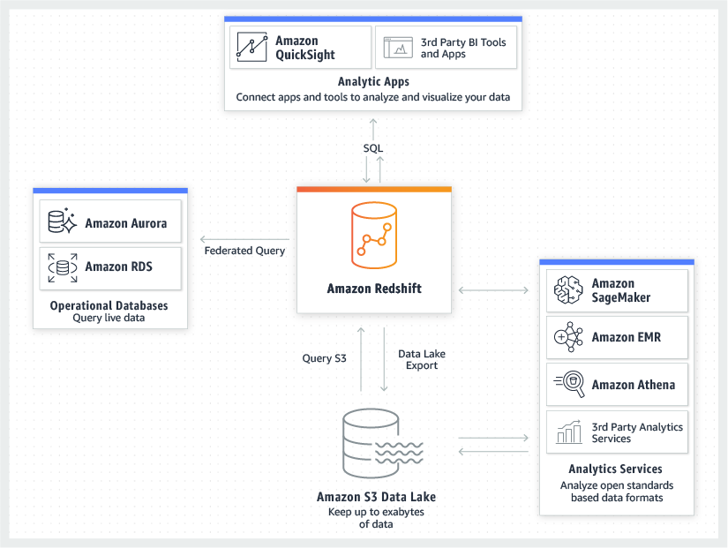
Amazon Redshift
Analyze all of your data with the fastest and most widely used cloud data warehouse

Slide 12
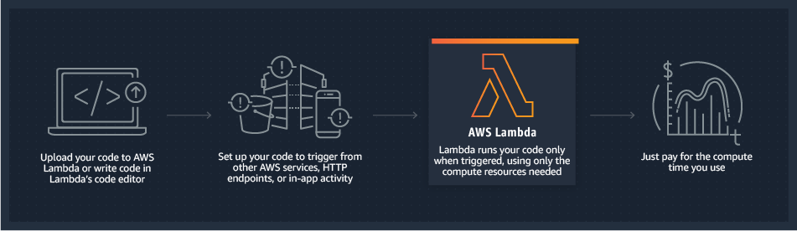
AWS Lambda
Run code without thinking about servers or clusters. Only pay for what you use.
Helpful in Data Processing, real time file processing, real time stream processing, Machine learning and many more…

Slide 13
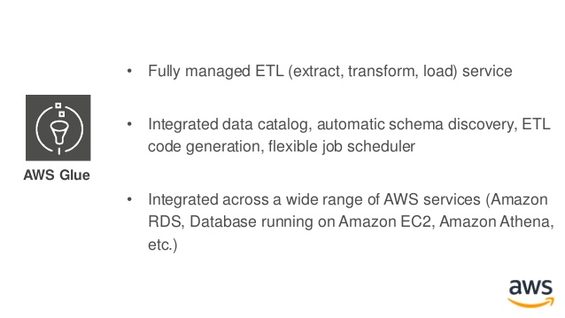
AWS Glue
Secure and resizable compute capacity to support virtually any workload

Slide 14
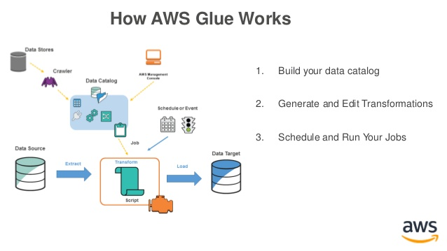

Slide 15
Hands on Labs:
Sign-in as a new user
Creating an Administrator IAM User and Group
Create Access keys for IAM User
Install and Configure the AWS Command Line Interface(CLI)

